Slide 1
Regression
(1 of 4)
Jeanette Mumford
Notes:
18 min

Slide 2
Goals
Basic understanding that regression is fitting a line to your data
Know what a residual is
Understand what “adjusting” means in the regression sense
  AKA, having more than one regressor in your model

Slide 3
A line
Assumption
RT = B0 + B1 Age + error
Reaction time (s)
Age

Slide 4
A line
How do you find the “best” line?
Reaction time (s)
Age

Slide 5
A line
Start by defining “best”
Reaction time (s)
Minimize the squared distance between our data and the line
Least Squares Estimate
Age

Slide 6
Residuals
Gray arrows
Mean is 0
Noise and leftover variability your model doesn’t describe
  Leftover variability will generally hurt you and should be avoided if possible
Reaction time (s)
Age

Slide 7
Focusing on the equation
RT = B0 + B1 Age + e
B0: RT when age is 0
B1: For each 1 year increase in age, RT increases by B1

Slide 8
Mean Centering
Often regressors are mean centered in regression
Often it serves no purpose
RT = B0 + B1 Age_DM
  B0: RT when Age_DM = 0 (mean age)
  B1: For each 1 year increase in age, RT increases by B1
Only changes interpretation of the intercept!

Slide 9
Reaction time (s)
Age

Slide 10
Reaction time (s)
Age-mean(Age)

Slide 11
Question
What if I had an error in my code that mean centered age and the mean was actually 10 (instead of 0)
  What is the interpretation of the intercept in that model?

Slide 12
Rule of thumb
Skip mean centering unless you’re interested in interpreting the intercept in a useful way

Slide 13
More than 1 regressor
We want to study the impact of caffeine on RT
  But we know Age impacts RT as well….and older people tend to drink less coffee*
We need to “adjust” our caffeine effect for age
  Remove age effect
  Our result for caffeine will reflect the caffeine/RT relationship for a fixed age
* I made this up, but have noticed as folks get older they cannot tolerate caffeine as well

Slide 14
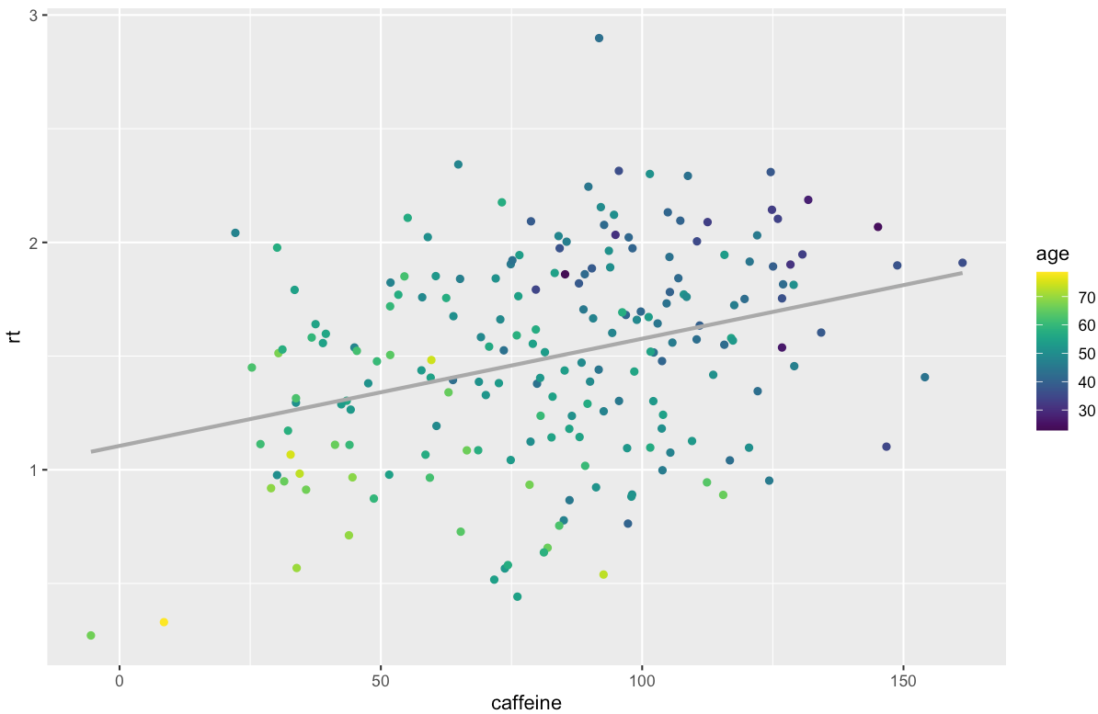
Original data

Slide 15
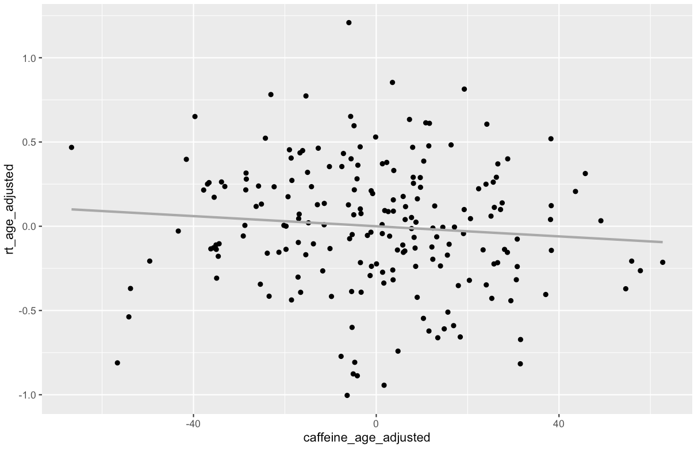
Data with age effect removed

Slide 16
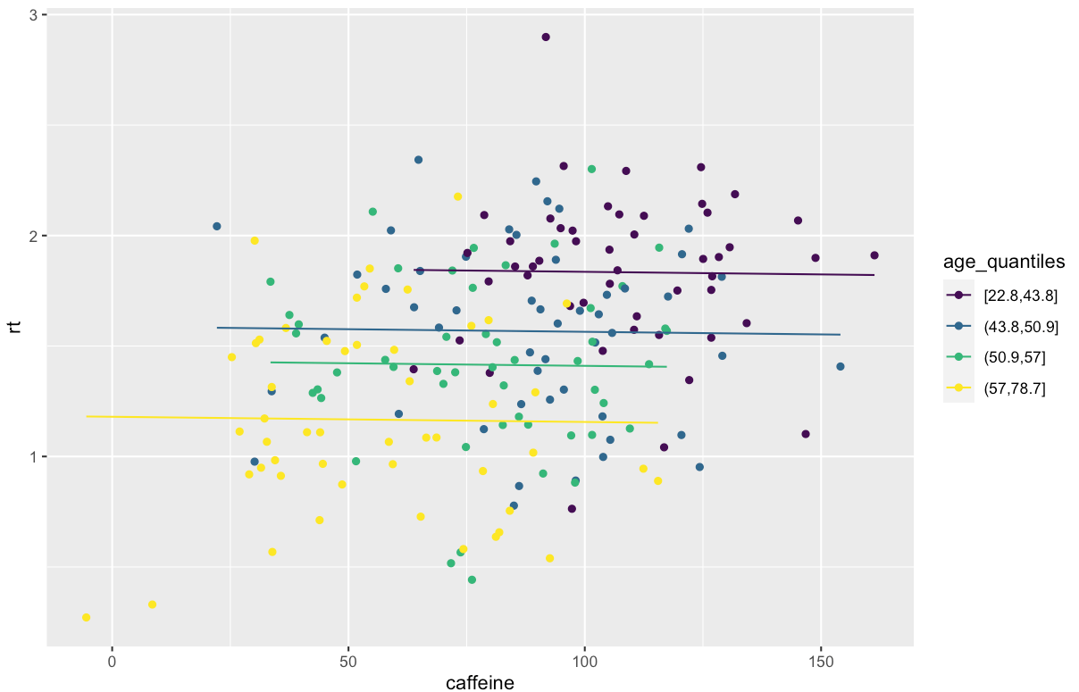
~ hand wavy example ~
(conceptually true)

Slide 17
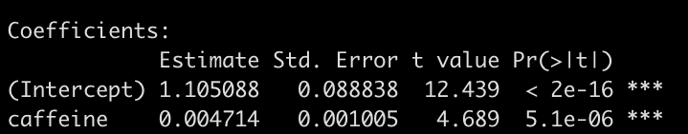
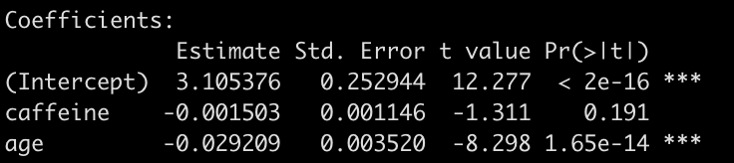
How the results stack up
Woo!
Oh!

Slide 18
Summary of “adjustment”
“Equates” your subjects according to confounding variables
  Sets it so comparisons are within any given age
    NOTE: NOT QUANTILES, that was a conceptual example
  Removes age impact

Slide 19
Summary so far
Regression models linear relationships
  Linear = linear combinations
  Obviously you can add a quadratic age term, for example
Adding multiple regressors mean each regressor’s parameter reflects that regressor’s contribution adjusted for the rest of your regressors

Slide 20
Things to remember
Regression minimizes the sum of squared error
  This error pertains to vertical distance from the estimated regression line to your data
  Least squares
Mean centering a regressor is only necessary if you want to make the intercept more interpretable
Adjusting can have a large impact on your parameter of interest

Slide 21
That’s it!

